Slide 1

MOCK UI
Presented By -
Tanberul Islam (1705033)
Jayanta Sadhu (1705047)
Md. Musharaf Hossain (1705050)

Slide 2
Tasks And Projects

Slide 3
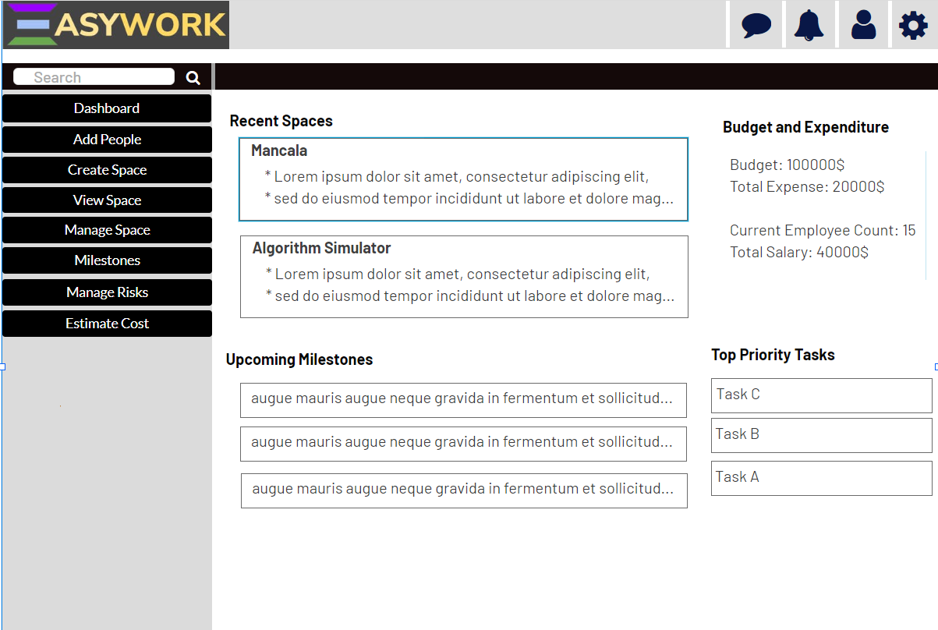
Home Page

Slide 4
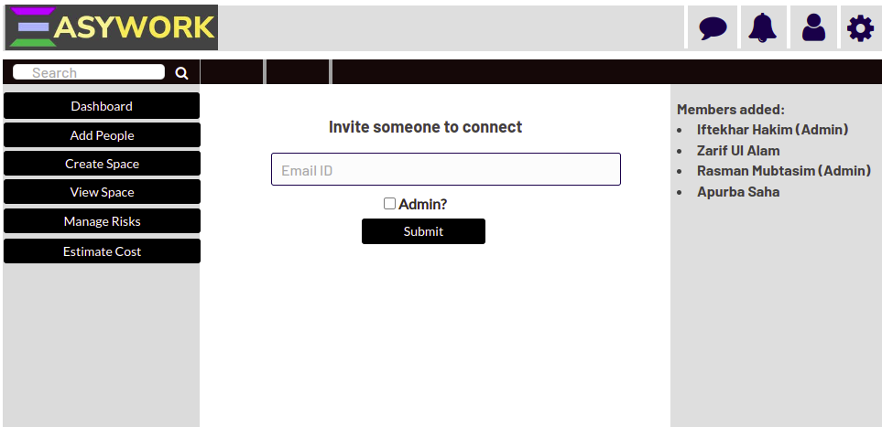
Add People

Slide 5
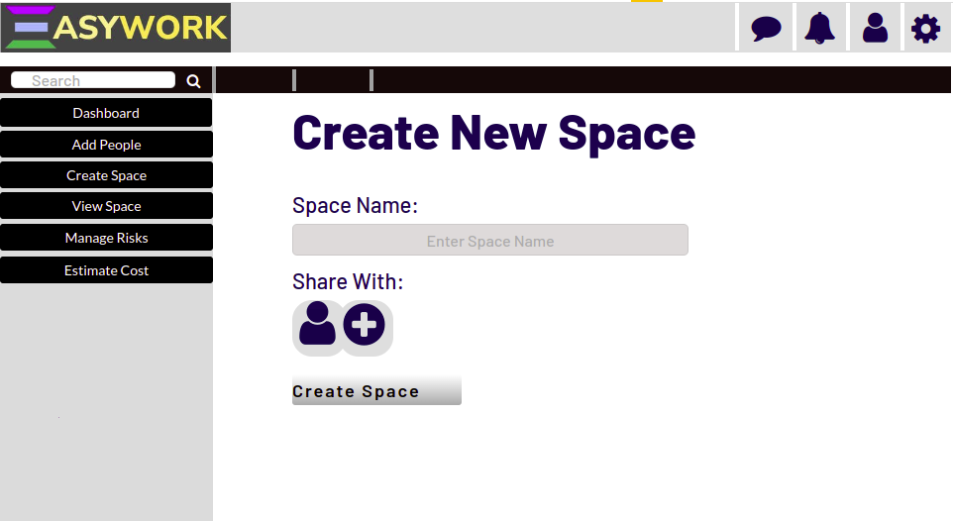
Create New Space

Slide 6
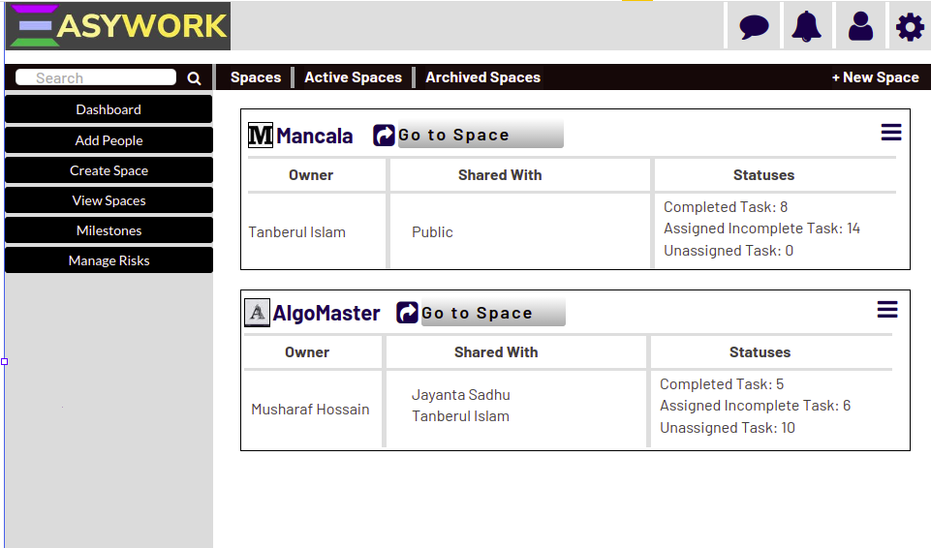
View Space

Slide 7
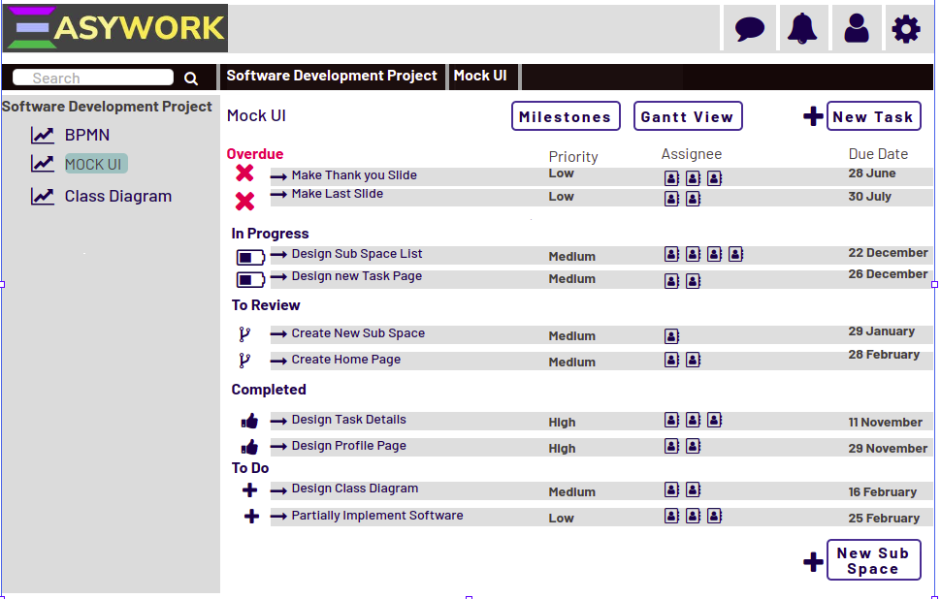
Space Details

Slide 8
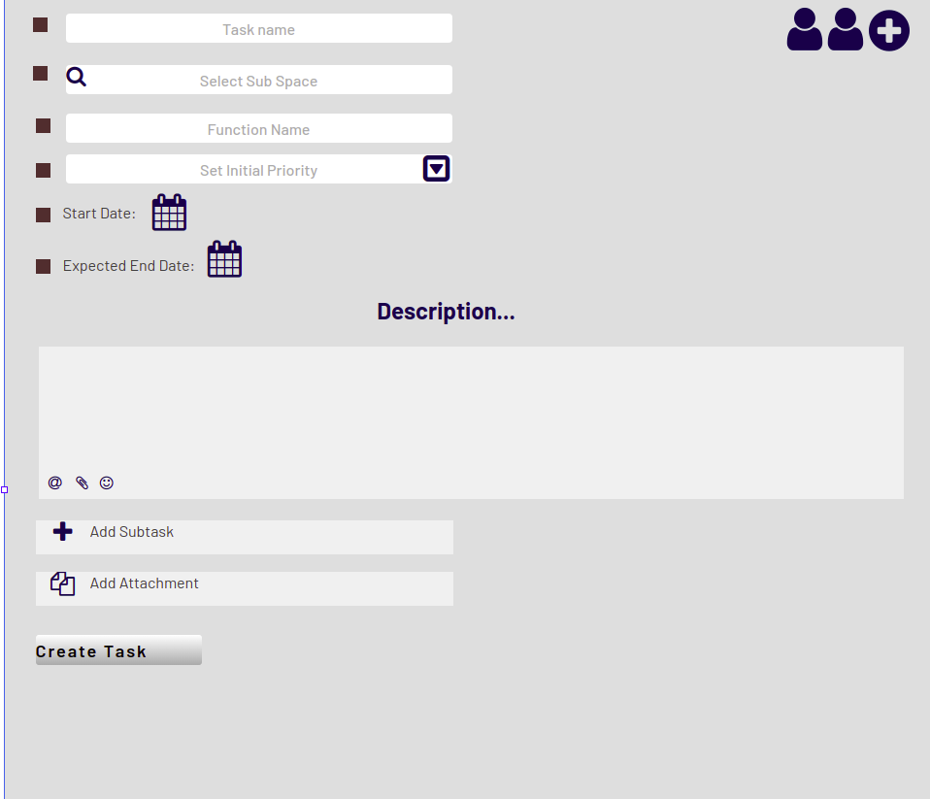
Create New Task

Slide 9
Space Details

Slide 10
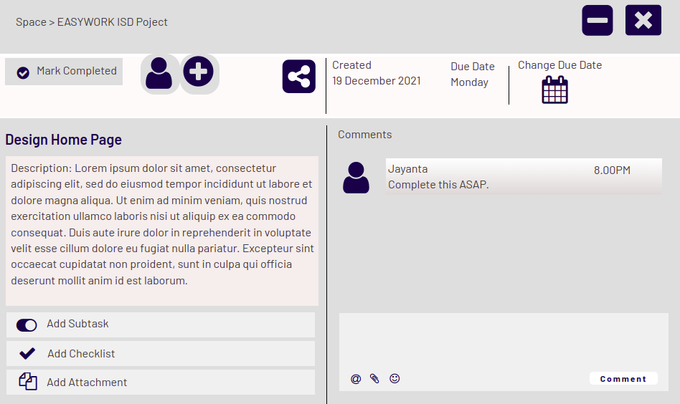
Task Details

Slide 11
Space Details

Slide 12
Time Management

Slide 13
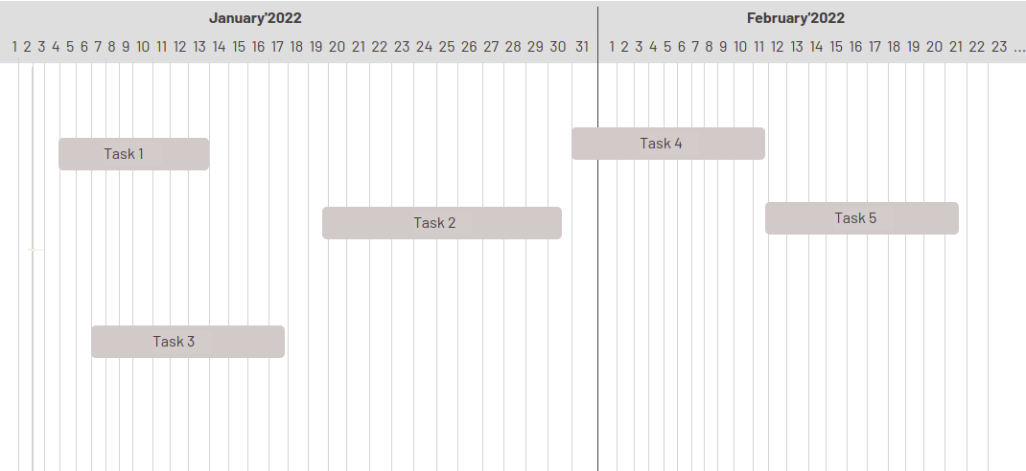
Gantt View

Slide 14
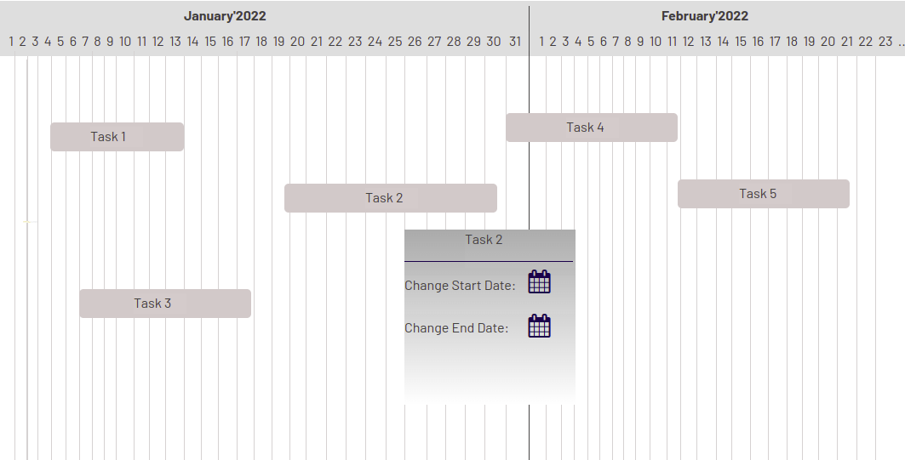
Gantt View Change Date

Slide 15
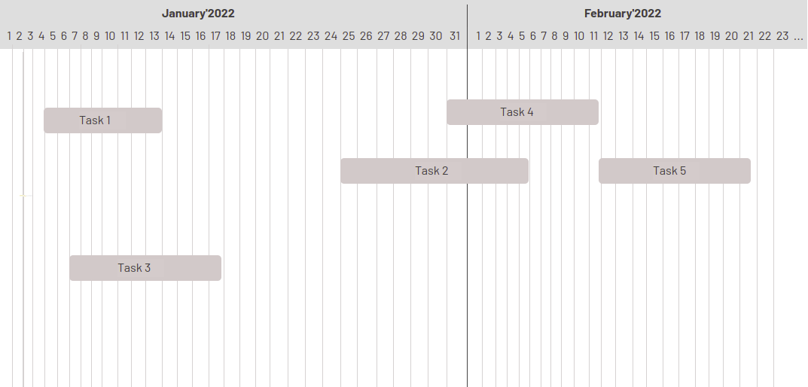
Gantt View After Change Date

Slide 16
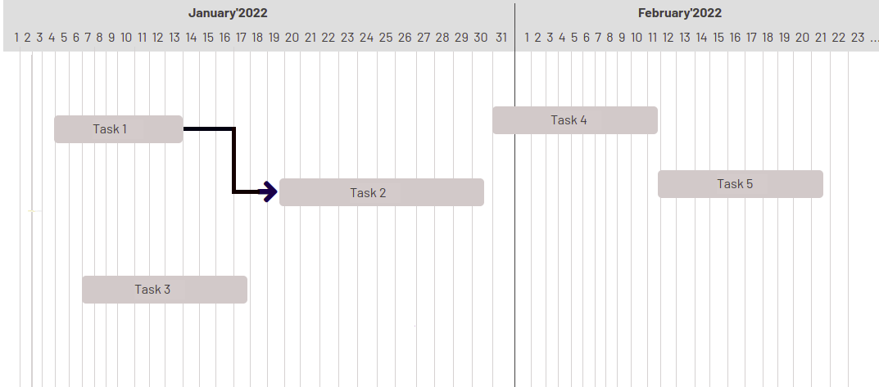
Gantt View Set Dependency

Slide 17
Setting Goals

Slide 18
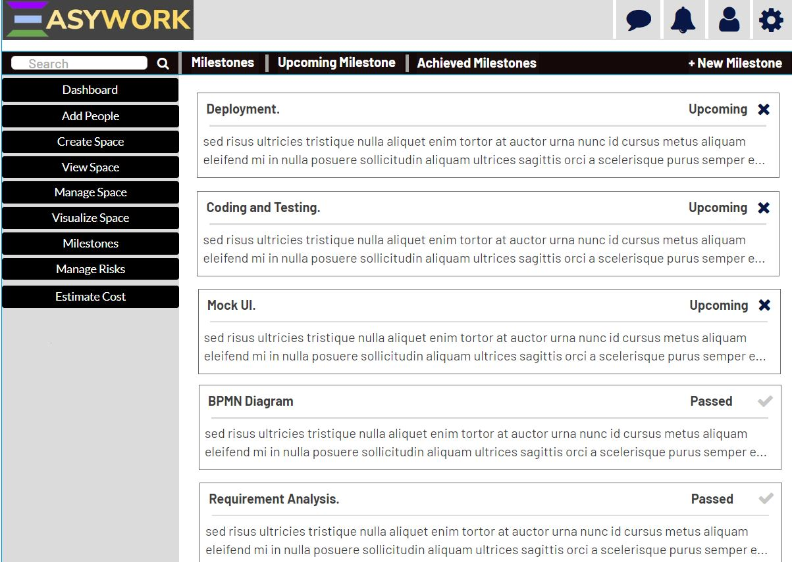
Milestones

Slide 19
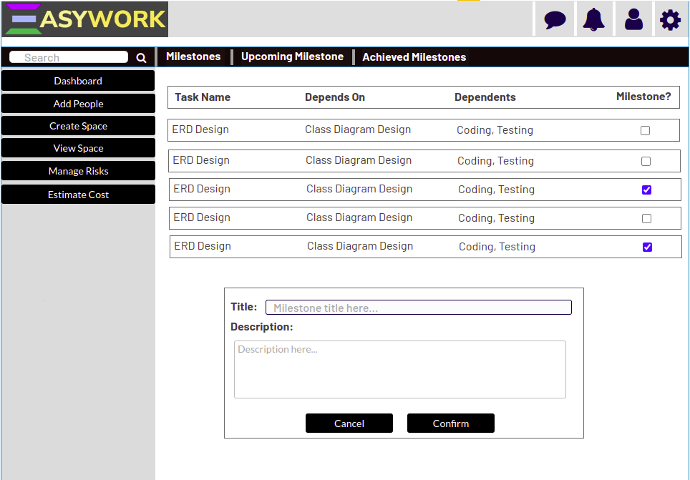
Milestone Details

Slide 20
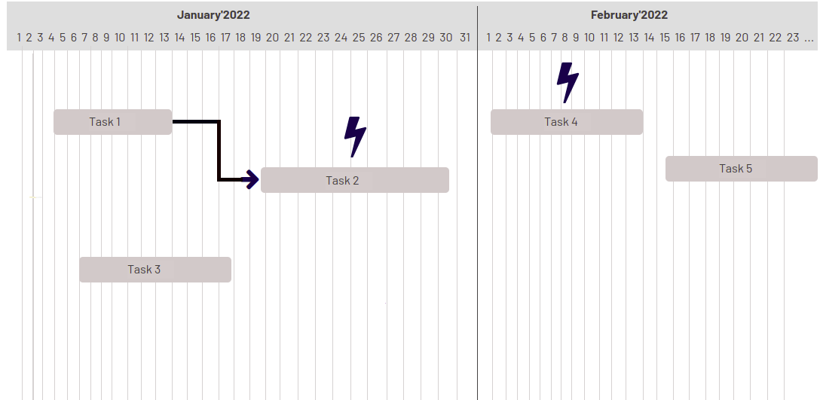
Gantt View With Milestones

Slide 21
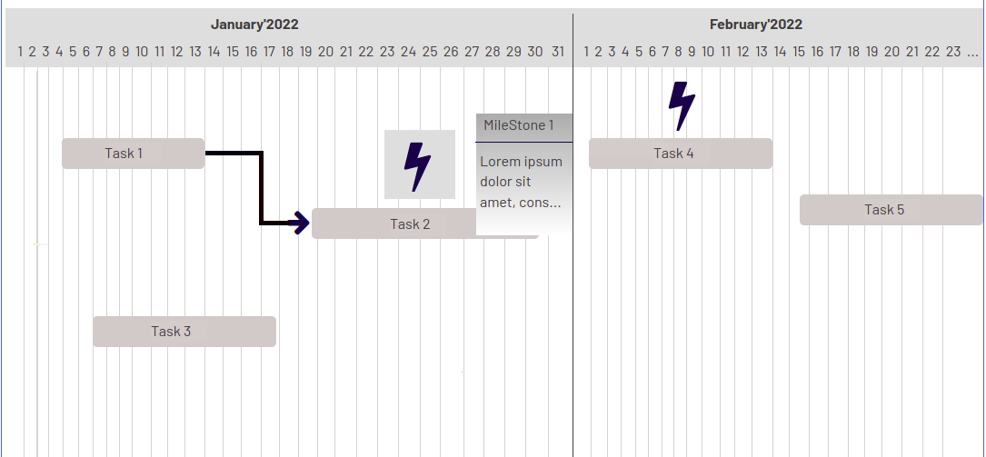
Gantt View With Milestone Details

Slide 22
Space Details

Slide 23
Task A
Low Priority
High Priority
High Priority
Task B
Task C
Task D
Task B was assigned most priority during assignment
Task E
Medium Priority

Slide 24
Cost Estimation

Slide 25
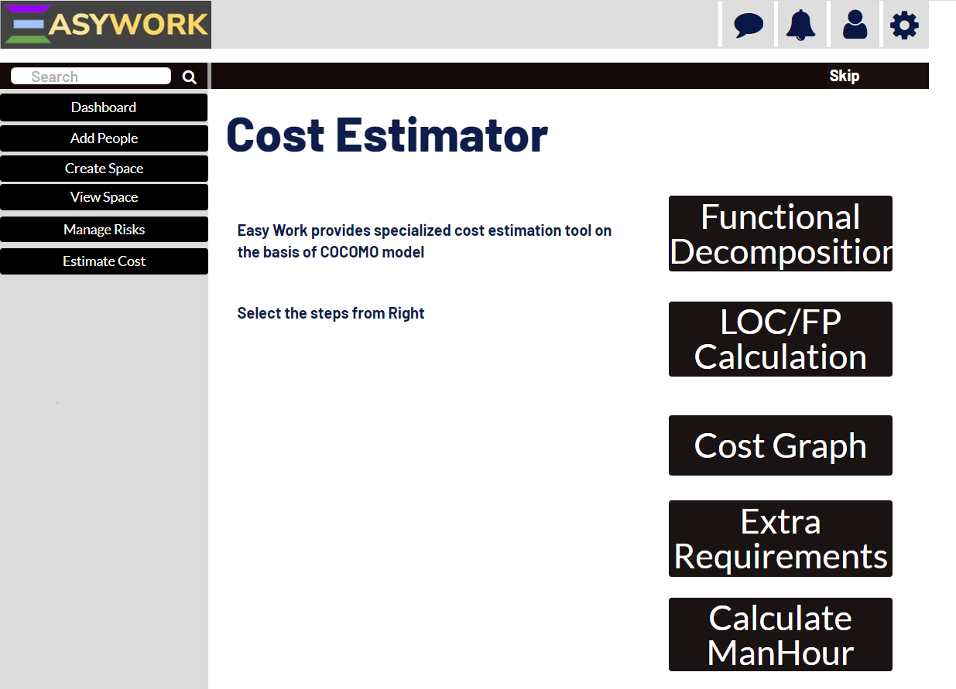

Slide 26
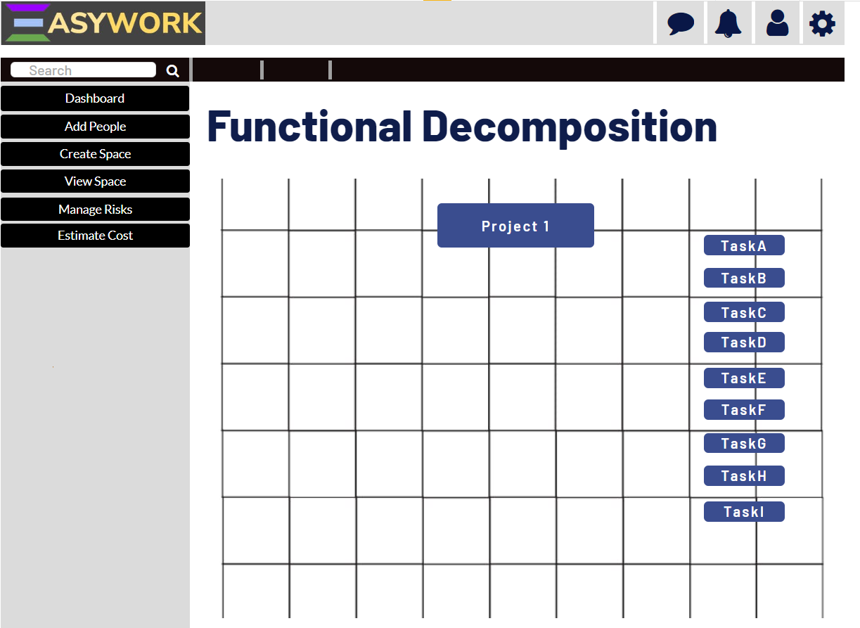
Functional Decomposition

Slide 27
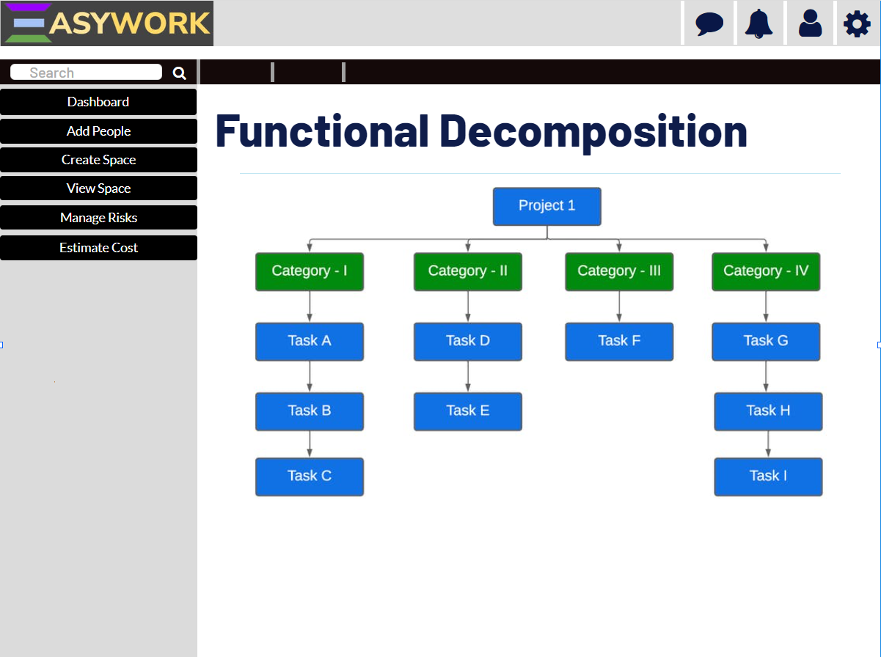
After Decomposing

Slide 28
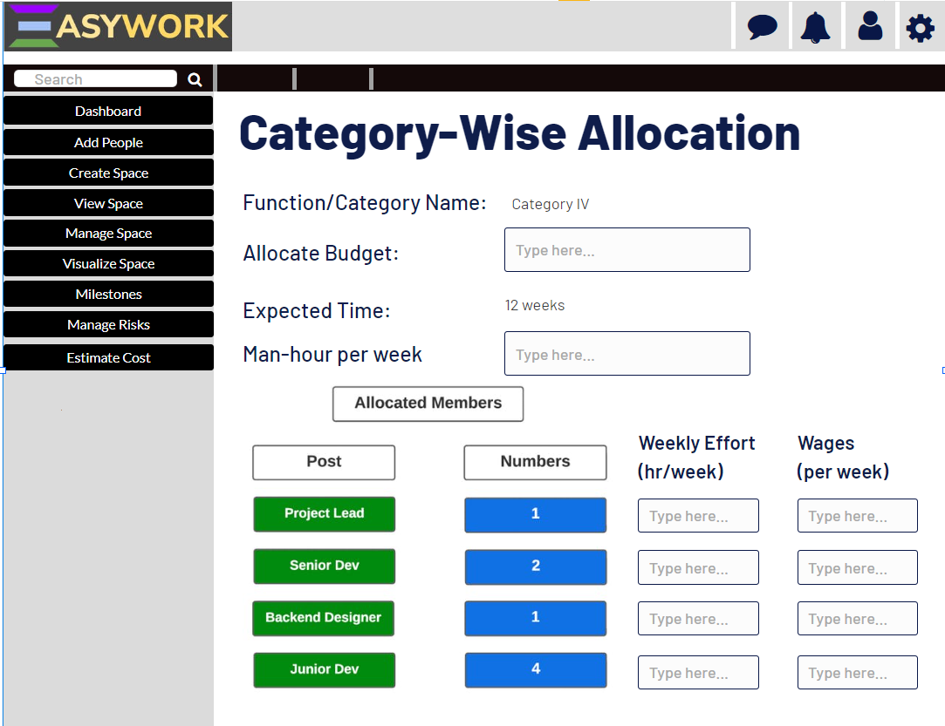

Slide 29
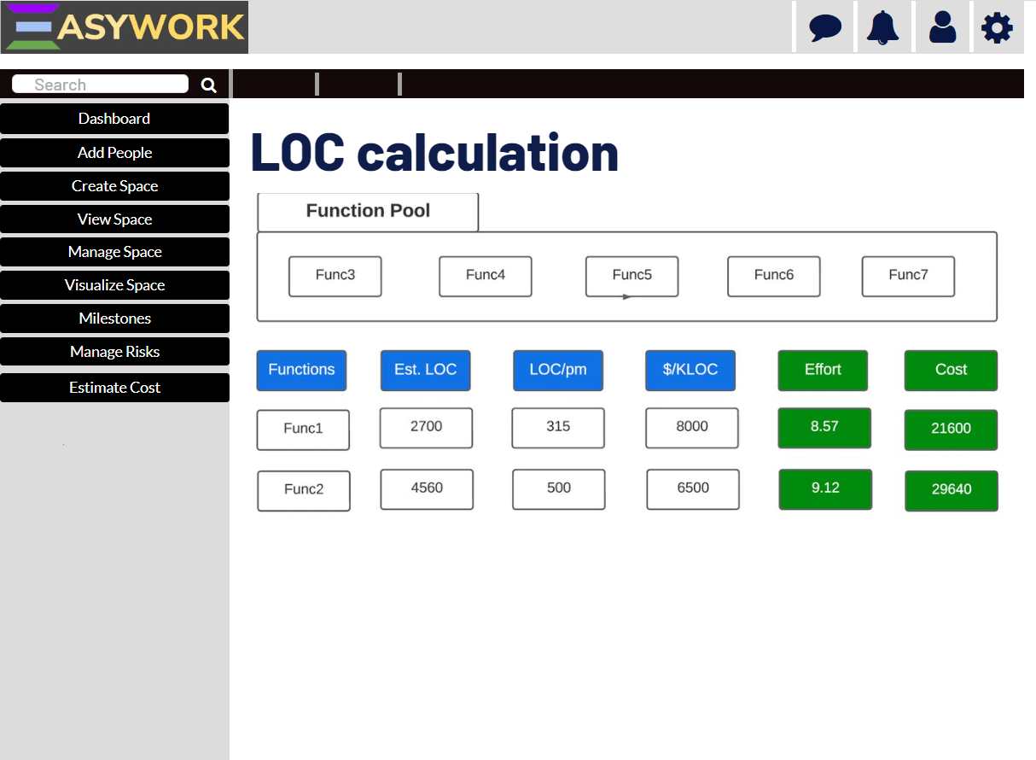

Slide 30
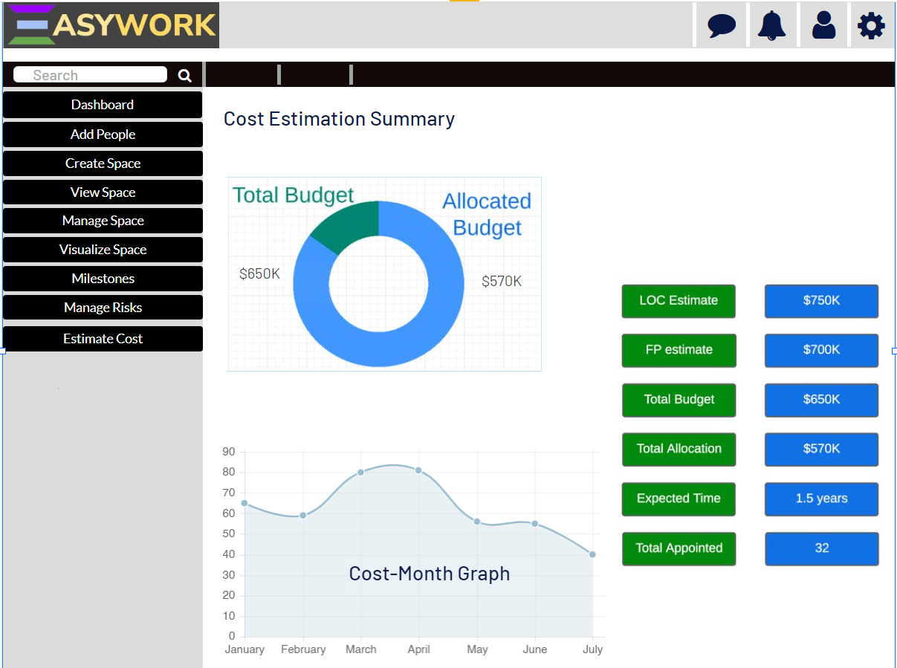
Cost Summary

Slide 31
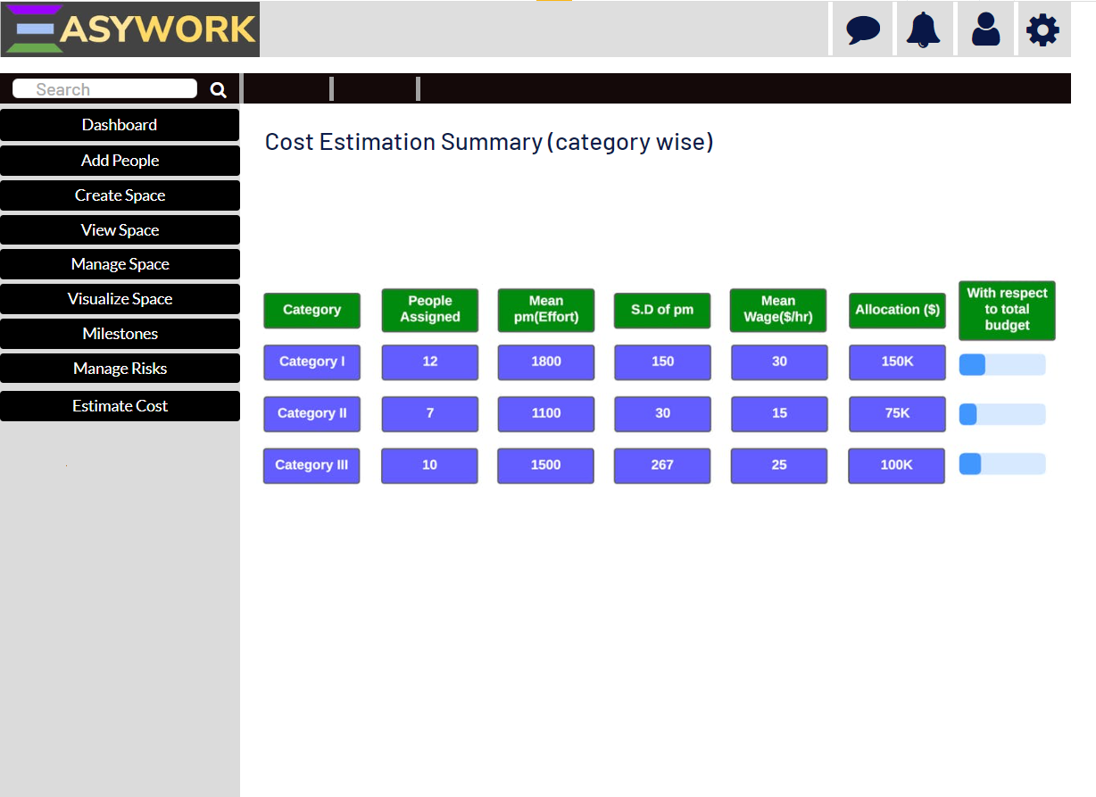
Category Wise Cost

Slide 32
Miscellaneous

Slide 33
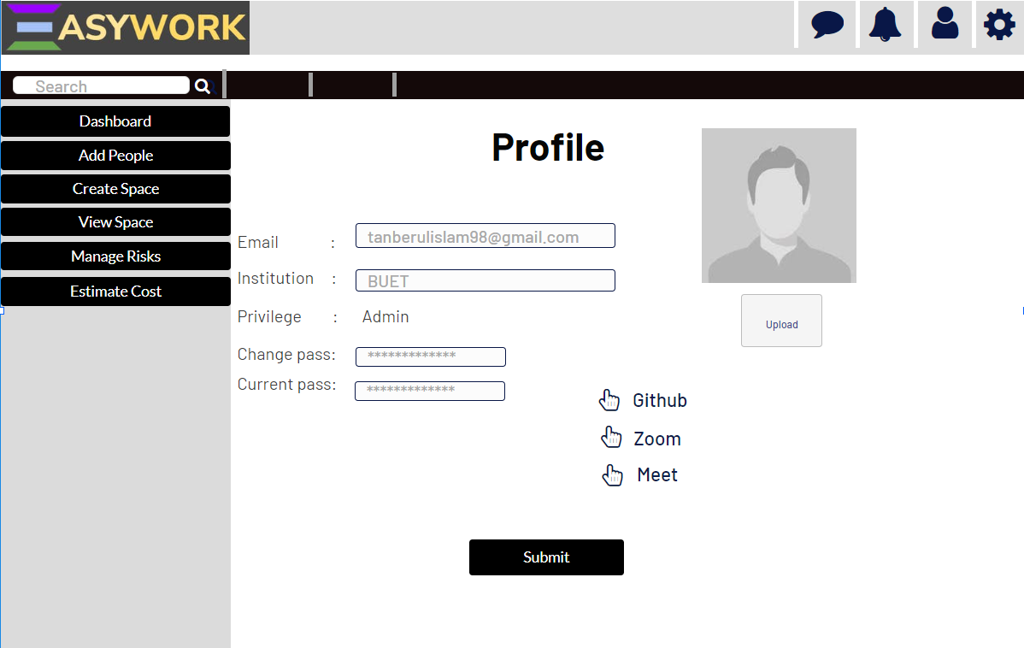

Slide 34
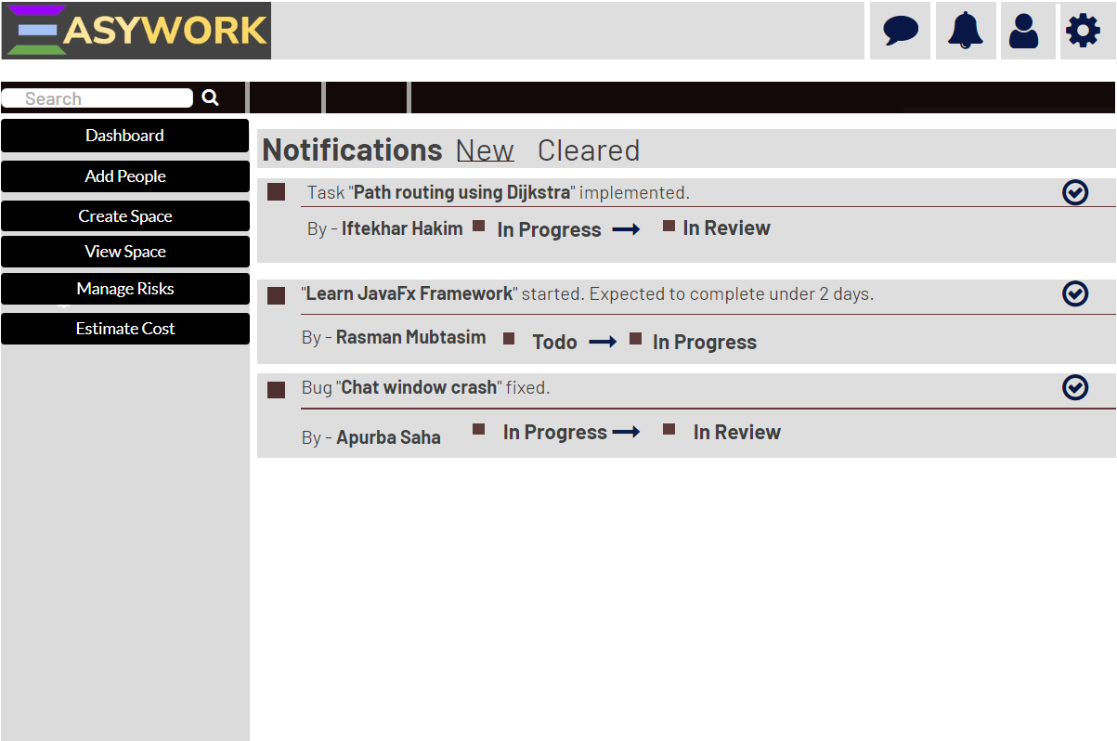

Slide 35
Thank You

